Slide 1





PokerWin Whitepaper
1st Decentralized Poker Game Platform on TRON

Slide 2

CONTENTS
About Us
Our Advantage
Game Fairness
Game Experience
Looking To Future

Slide 3
About Us

Slide 4
About Us
The rise of the APP economy has changed people’s daily living habits from all angles.
At present, DAPP based on Blockchain technology is still in the early stage of exploration, and there is no DAPP with large-scale practical application value. The vast majority of DAPPs are still throwing dice, exchanges, pets, etc. The scene is single and the user experience is poor.
So we came up with an idea of combining the most popular poker game ‘Texas Holdem’ and Blockchain together so the players can enjoy the security, freedom, transparency, traceability and other benefits brought by decentralization, and completely avoid the exploitation of the centralized gaming game providers.

Slide 5
Our Advantage

Slide 6
Our Advantage
The game process is transparent and fair
No dealer or Super player
The process of shuffling is performed by all players participating in the game and confirms the final result. The result of shuffling alone cannot be manipulated by the dealer or a certain player.
All players in the game are equal, there is no super player or dealer. The final game's results and process data will be packaged into block data and stored on the chain, open to all players.
01
02
Fair and safe game environment
Best poker game experience
03
04
Join the game with TronLink
Sensitive information such as user accounts and balances will no longer be stored in the server of the traditional centralized solution, thus fully protecting the player's account privacy and security.
The best decentralized Texas Hold‘em game experience now. We will continue to work hard to ensure the continuous optimization of the player experience.

Slide 7
Game Fairness
About Shuffle
Fund settlement

Slide 8
Shuffle
Centralized online poker is unfair
Centralized online poker game, all shuffling processes are controlled by a centralized game server, which is opaque to the player, and the centralized server can easily manipulate the process and results.
Our platform makes full use of the decentralization principle to ensure the fairness of shuffling
The shuffling result is determined by all Players and Dealers.
The SEED generated by player and dealer will be saved on the chain, the process is open and transparent.

Slide 9
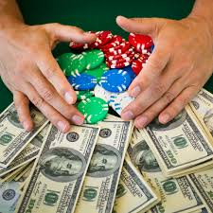
Fund Settlement
Player information submit on chain before the start of each game
Player's position information
Chip amount information brought in by the player
SEED information for shuffle
After the end of each game, Dealer informs the winning player to package the results of the game on chain, including
The position of winning player
SEED information for shuffle
All player revenue
Game process information
The player’s revenue is executed in real time by smart contracts deployed on the TRON chain and immediately reflected on the player’s chip information.
If the player leaves the game, the remaining chips will be converted into TRX.

Slide 10
Game Experience
Basic Function
Game Table
Service Fee
Price Pool

Slide 11
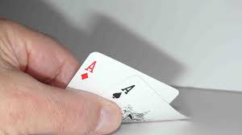


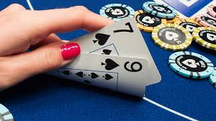
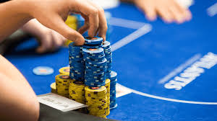


Basic Function
Current Function
Game room selection & entry
Game table sharing & invitation function
Support TRON wallet
TRX exchange game chips
Prize pool accumulation & distribution

Slide 12
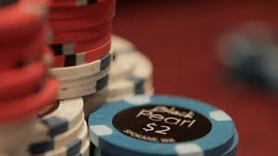
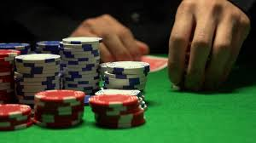
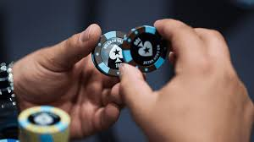
Game Table
Blind Structure | Table number | Min Buy-in | Max Buy-in
5/10 | 10 | 50BB | 250BB
10/20 | 12 | 50BB | 250BB
20/40 | 12 | 50BB | 250BB
50/100 | 6 | 40BB | 250BB

Slide 13

Service Fee
For game pots, the platform will deduct a certain percentage of chips and form a public prize pool.
The service fee will only be deducted from the pot of the winning player.
The deducted service fee will be accumulated in the prize pool and will be redistributed periodically.
Service fee collection ratio
5/10 Table: 3% from Pot, Minimum 1TRX
10/20 Table: 3% from Pot, Minimum 2TRX
20/40 Table: 3% from Pot, Minimum 4TRX
50/100 Table: 3% from Pot, Minimum 10TRX

Slide 14
Price Pool
Allocated every three days
Players participating in the Top 20 game lot allocate 50% of the prize pool according to the number of lots.
Top 3 players in the profit ranking allocate 5% of the prize pool in proportion to 50%/30%/20%.
The largest Top3 hand in the winning hand allocate 5% of the prize pool by 50%/30%/20%.
Lose the game's Top3 hand allocate 5% of the prize pool by 50%/30%/20%.
Players with a total profit ranking of Bottom3 allocate 10% of the prize pool by 50%/30%/20%.
Reserved for subsequent game operations and new feature development.

Slide 15
Looking To Future
Roadmap
Token
Our Vision

Slide 16
Roadmap
Current
2019.1
2019.3
2019.6
Online Version
Enhanced Version
Tournament Version
Ultimate Poker Version
Regular Texas
Support TronLink
Chips Buy-in
Game table sharing & invitation
Prize pool accumulation & distribution
Game table subscription
Token issue
Game friend
Friend invitation & profit share
Private game table
Support more wallet
SNG/MTT
Team system
Player achievement system
Player leaderboard
table rules customization
Black Jack
Baccarat
More

Slide 17
Token Issue
Issue PKC (PokerWin Coin) one month after online
Play the game
Play games and redeem TRX to get a certain percentage of PKC gifts.
You can mine PKC in a variety of ways to be our shareholder.
Subscribe a table
Get PKC as gift, if you subscribe a game table.
02
PKC plans to enter the exchange in the future.
01
03
Focus on the token white paper for more details.
Prize pool allocation
When the prize pool is allocated, you will also get a PKC gift when you get TRX.

Slide 18

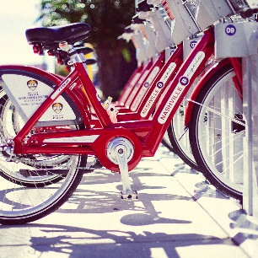



Our Vision
Player
Become the world‘s best decentralized poker gaming platform, providing players with the most secure and best-selling multi-player competitive gaming experience. In this process, share growth income with shareholders and players.
Shareholder
Founding team

Slide 19
Thank you for your trust
Let us grow together in the future
感谢您的观看
THANK YOU FOR YOUR WATCHING

